Slide 1
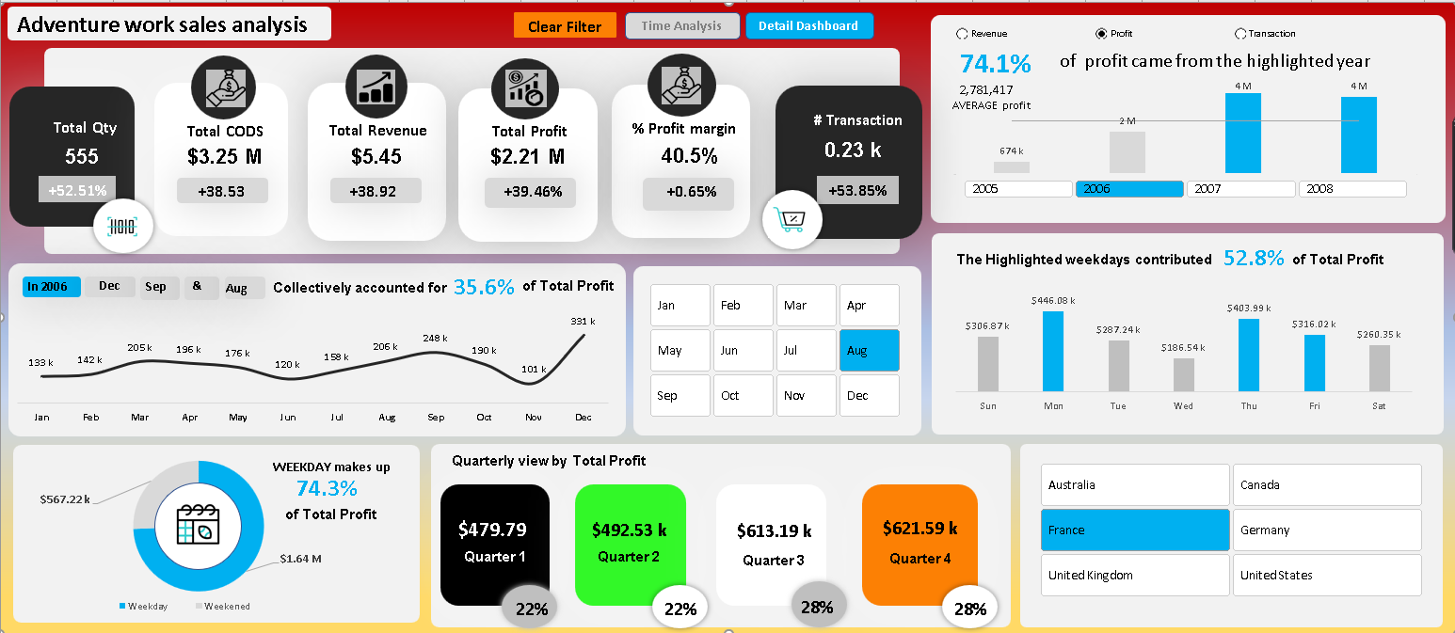
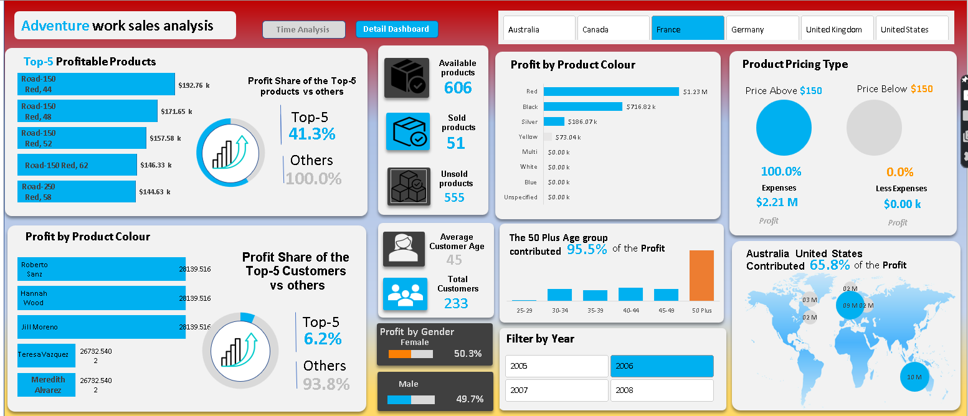


Backend analysis of Adventure work Sales Dashboard (Part 1)
Tool: Microsoft Excel

Slide 2
Content
Data Files
Data Loading
Data Connection for Modelling
Data Cleaning
Remove N/A & Null Column
Replace Value
KPIs preparation
Custom column
Conditional column
Merge column
Relation ship diagram
My learning

Slide 3
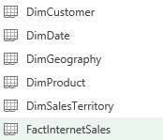
Data Files
This data file consist of 6 files

Slide 4
Data Loading Method
Open Excel
Go in to data
Select Get data option
From file
From Excel work book

Slide 5
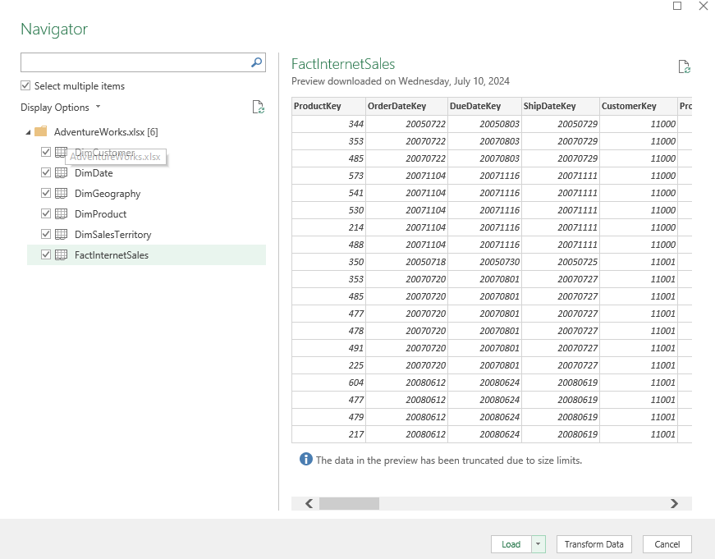
Data Loading Procedure
After Select From Excel Work book Navigation File will appeared
Select Multiple option
Select Load Option
Load & Load to Option will appear
Select Load to option

Slide 6
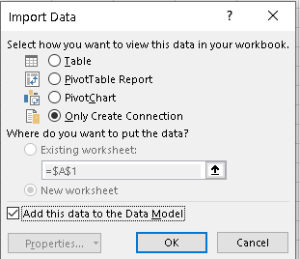
Data Loading Procedure
Select Load to option
After Load to option Import Data Dialog Box will be appear

Slide 7
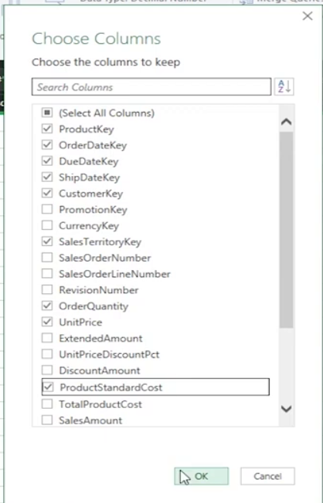
Data Cleaning of First Fact Internet Sales Sheet
In Power Query editor go into home option and select choose column
Than select importance column which is necessary for analysis

Slide 8
KPIs Preparation
In Power Query editor go into home option
select choose column Select In fact Internet Sale sheet
go in to add column and select Custom column
Total Revenue
Formula: order quantity * unit price
CODS
Formula: order quantity * Cost
Total Profit
Formula: Total Revenue-CODS
Total Profit
Formula: Total Revenue-CODS

Slide 9
KPIs Preparation
Total Revenue
Formula: order quantity * unit price
In Power Query editor go into home option
select choose column Select In fact Internet Sale sheet
go in to add column and select Custom column
CODS
Formula: order quantity * Cost
Total Profit
Formula: Total Revenue-CODS
Total Profit
Formula: Total Revenue-CODS

Slide 10
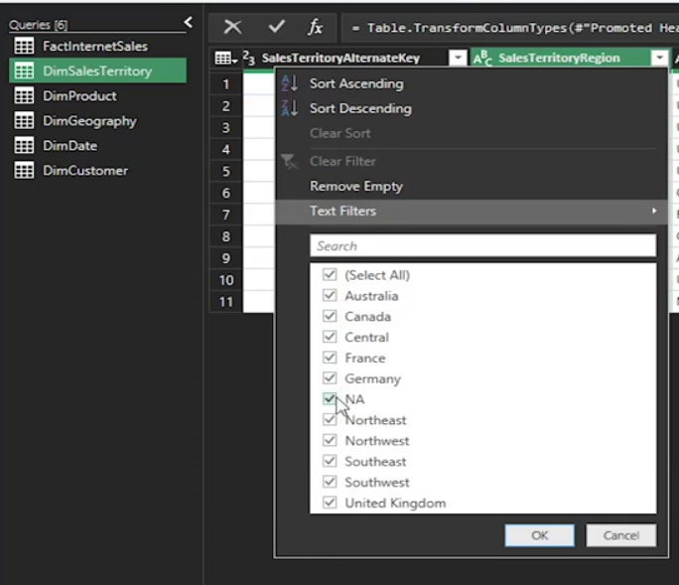
Data Cleaning of Second Dim Sales Territory Sheet
In Power Query editor Select Dim Sales Territory
Than select check all column and remove NA

Slide 11
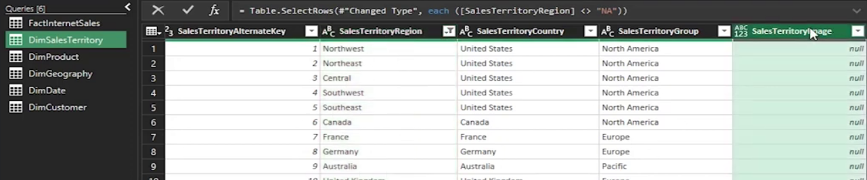

Data Cleaning of Second Dim Sales Territory Sheet
In Power Query editor Select Dim Sales Territory
Than check Remaining column and remove null

Slide 12
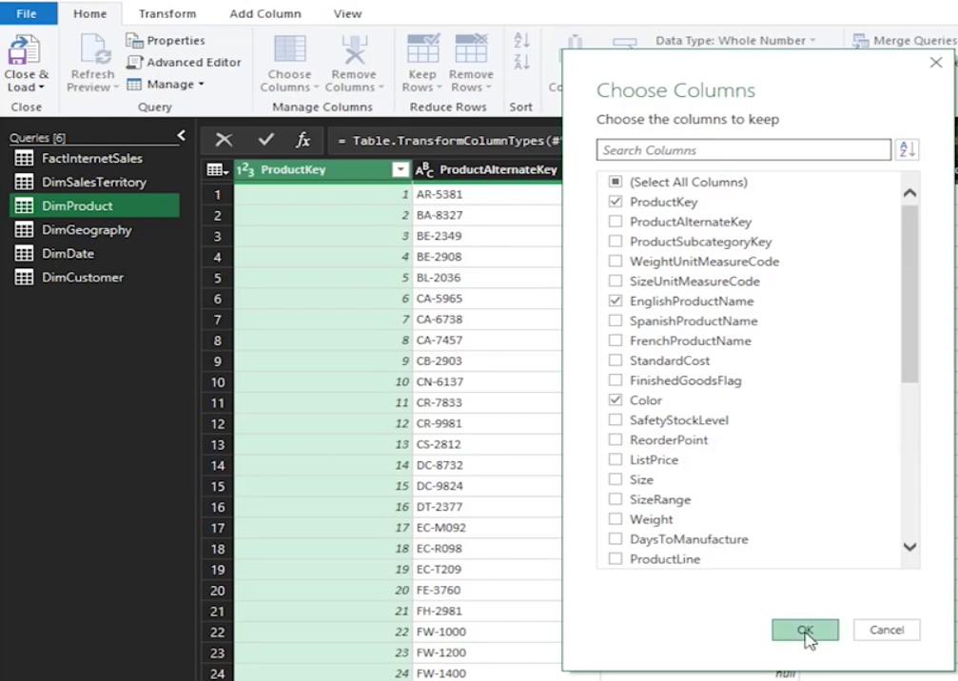
Data Cleaning of 3rd Dim Product Sheet
In Power Query editor go into home option and select choose column
Than select Dim Product importance Sheet and select some column which is necessary for analysis

Slide 13
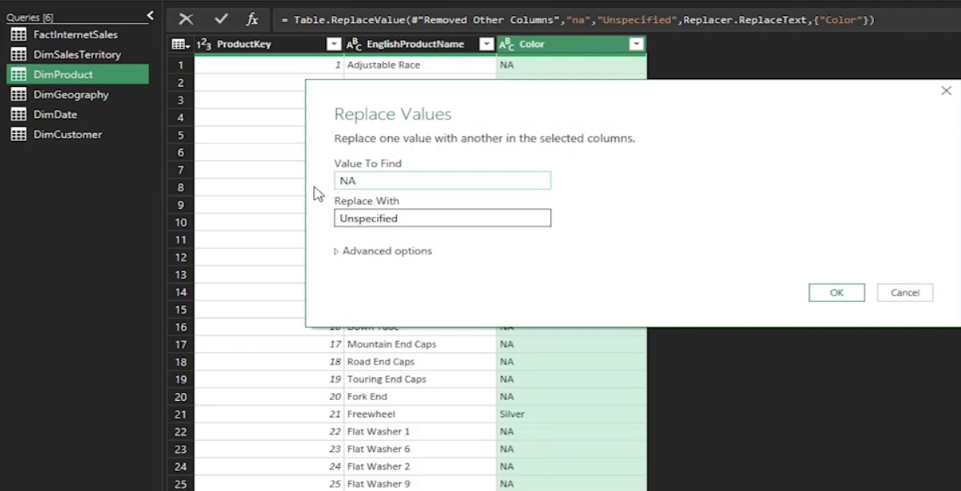
Remove Duplicate from 3rd Dim Product Sheet
In Power Query editor go into home option and select Color column
Than right click on it
And select Replace Value

Slide 14
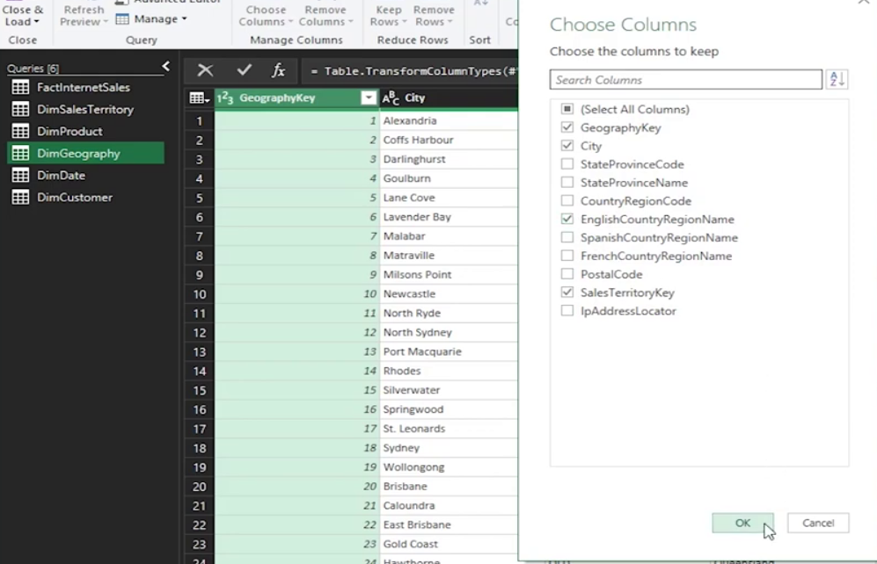
Data Cleaning of 4th Dim geography Sheet
In Power Query editor Select Dim geography than go into home option and select choose column
Than select importance column which is necessary for analysis

Slide 15
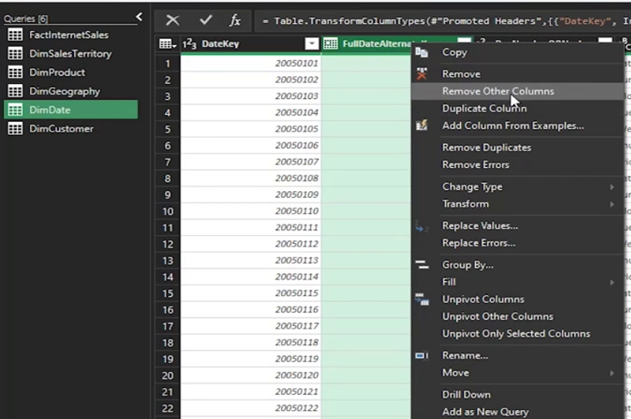
Remove other column from 5th Dim Date Sheet
In Power Query editor Select Dim Date than go into home option and select choose column
Than Remove other column which is not necessary for analysis.
Than change column Name.

Slide 16
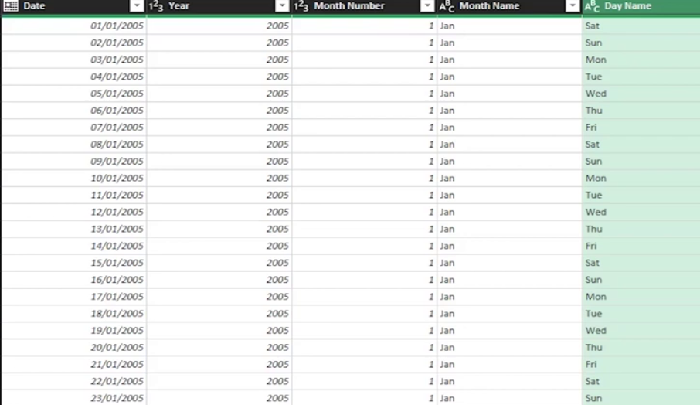
Add Column in 5th Dim Date Sheet
In Power Query editor Select Dim Date than go into add column and select date option and select year, Month number, Month name & Day name.

Slide 17
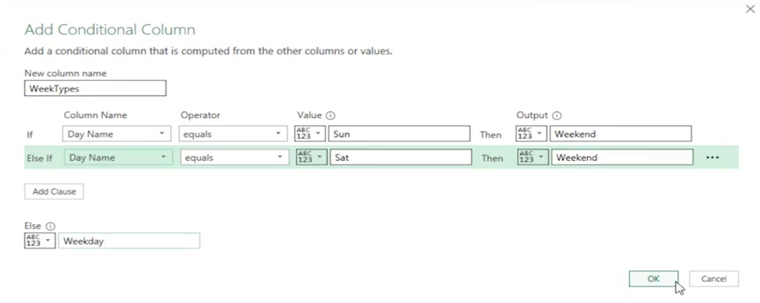

Applying Conditional Column of 5th Dim Date Sheet
In Power Query editor Select Dim Date than go into add column and select Add Conditional column option and select year, Month number, Month name & Day name

Slide 18
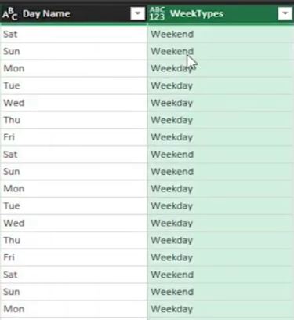
Conational Column result of 5th Dim Date Sheet
Result will Highlighted with Green Color
Than change data type in text

Slide 19
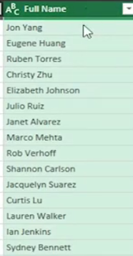
Merge Column from 6th Dim Customer Sheet
In power query editor go in to transform option and select merge column with full name.
Result will Highlighted with Green Color.

Slide 20
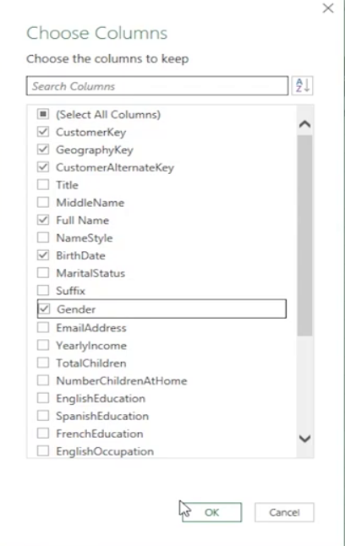
Choose Column from 6th Dim Customer Sheet
In Power Query editor go into home option and select choose column
Than select importance column which is necessary for analysis

Slide 21
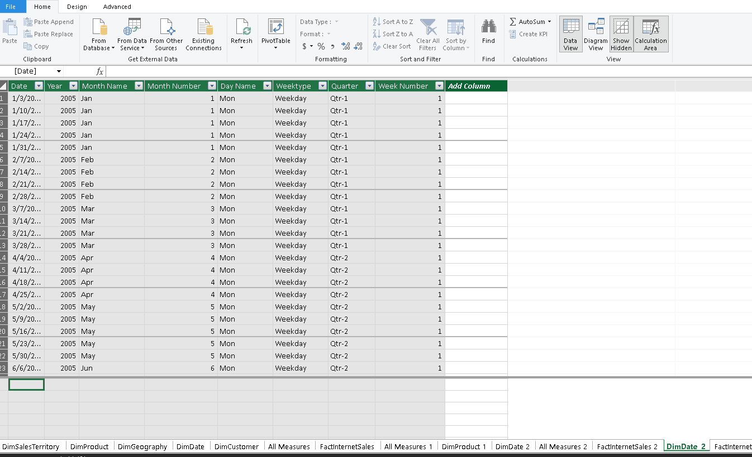
Manage Relationship
After load and close all sheet
Go in to power pivot and select manage

Slide 22
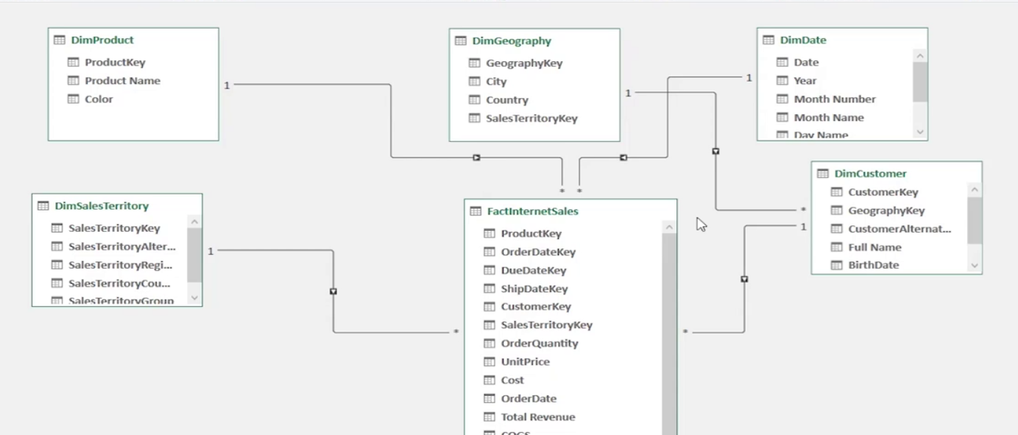
Data Diagram
Go in to power pivot and Diagram View

Slide 23
My Learning
How to import data?
How to load data?
How to create connection?
How to clean data?
How to merge data?
How to change data type?
How to remove NA , Null, missing and empty column?
How to edit relationship?
How to use conditional column and add custom column?
How to transform data?
How to creating KPIs preparation?
How to use prefix and suffix?
How to transform date in to day, year, week type, week day, quarter, and month name and month number?

Slide 24
Thanks
Stay Tuned for next Part …
Mahnoor Naseer
mahnoornoorg57@gmail.com

